Slide 1
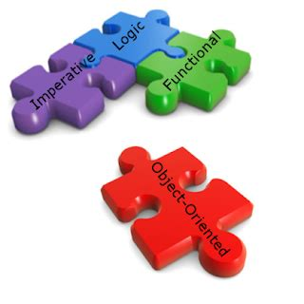
Programming Paradigm

Slide 2
Objectives
State what is a programming paradigm
Describe different types of programming paradigms
State the differences between programming paradigms
Cite examples of programming languages for the types of programming paradigms
Give the advantages and disadvantages of programming paradigms

Slide 3
Review Questions Record your answers in your copy books for review
What is a programming language?
What is high level language?
What is low level language?
List the different generations of programming languages
Give the two types of programming language
What is the difference between assembly and machine code
List the different generations of programming language

Slide 4

Listen to the video on the proceeding slide and record the answer to this question in your copy books
What is a programming paradigm?

Slide 5
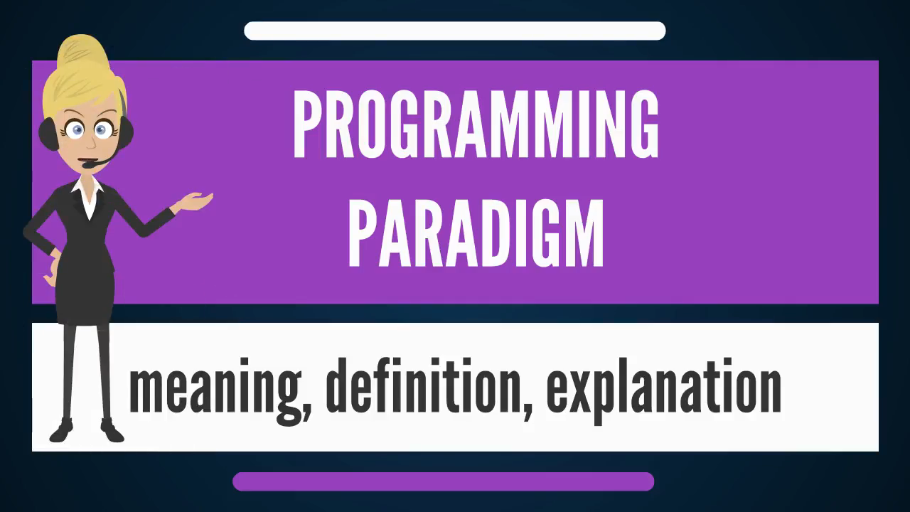
Watch the video and make salient points in your copy books
https://www.youtube.com/watch?v=ZIjeAEEuMoI

Slide 6
Programming Paradigm
The term programming paradigm refers to a style of programming.
It does not refer to a specific language, but rather it refers to the way you program.
It gives us a set of guideline on how to write entire program
There are lots of programming languages that are well-known but all of them need to follow some strategy when they are implemented, and that strategy is a paradigm.

Slide 7
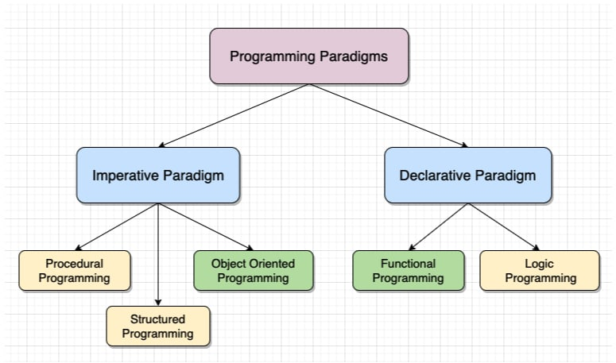
TYPES
There are lots for programming language that are known but all of them need to follow some strategy when they are implemented, and this methodology/strategy is paradigms

Slide 8
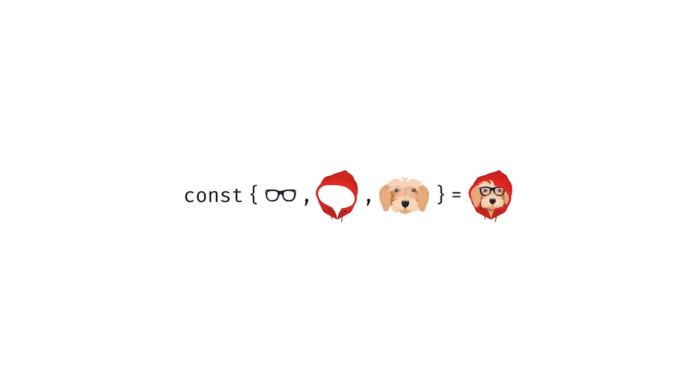
Watch the video
https://www.youtube.com/watch?v=JqvMTwnbhnA

Slide 9
Imperative
The programmer writes instructions that tell the computer what to accomplish and how to do it.
The imperative programming code focuses on creating algorithms that tell the computer how to do things.
It closely relates to how hardware works.
Based on the Von Neumann architecture

Slide 10
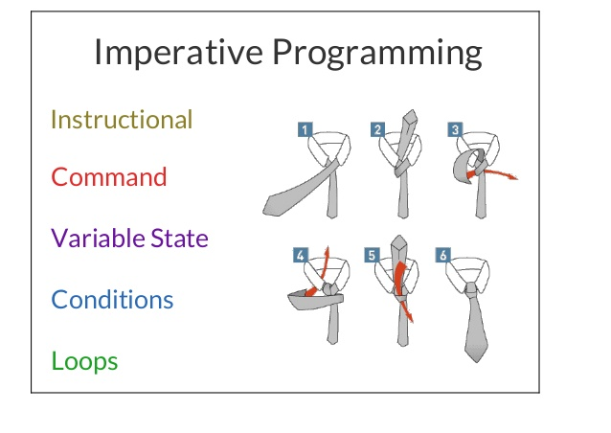
Stages in tying a tie
Imperative programming paradigm is concerned with HOW you’re actually going to get to the solution

Slide 11
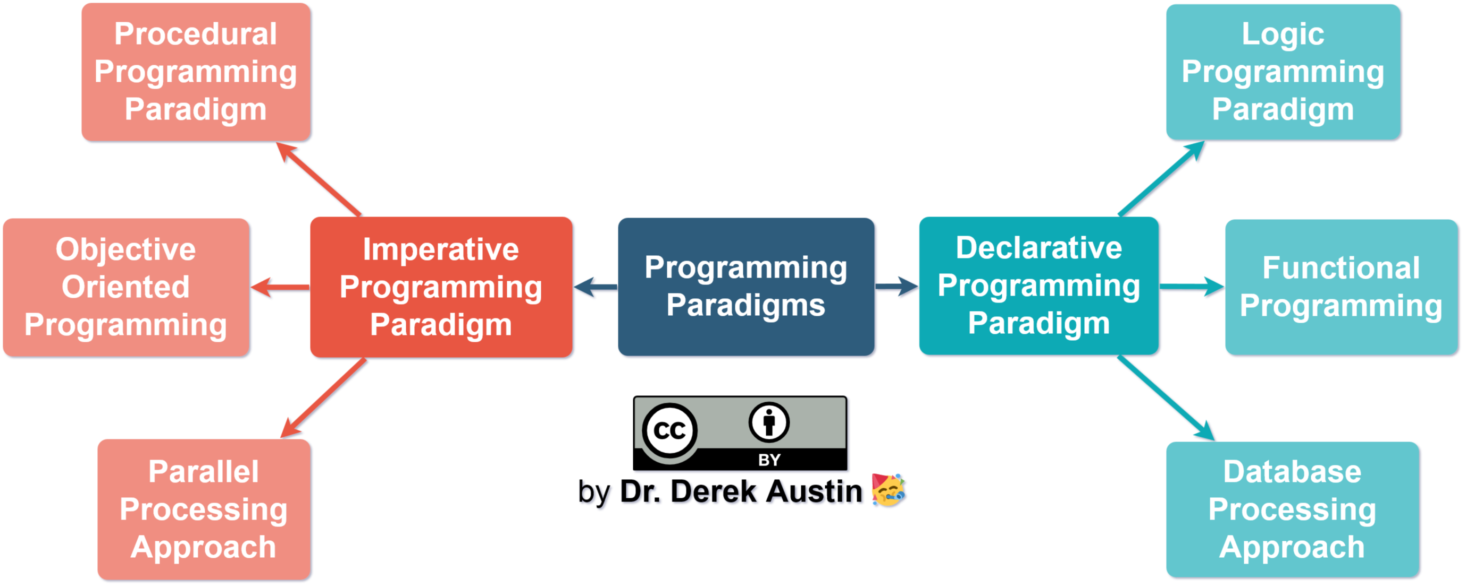
Types of Imperative Programming Paradigm

Slide 12

Procedural Programming Paradigm
This language deals with procedure calls, which are also known as routines or functions.
These functions or routines can easily be reused in different parts of the program.
One benefit of this is that the code can be easy to learn and read in simple programs, though when dealing with something more complex you run the risk of ending up with a huge volume of code.
Examples: C, Pascal, BASIC.

Slide 13
Object-Oriented Programming (OOP)
This paradigm is based on the idea that code can be broken down into ‘objects’ that have different properties and perform different actions.
Objects can interact with each other to achieve desired outcomes.
A core principle of OOP is ‘encapsulation’, which involves wrapping all the object components (i.e. data and methods) into a single, self-sustaining unit (sometimes known as a ‘class’).
Due to encapsulation, objects/classes can be reused easily, while it is also scalable and secure.
Examples: C++, Java, Python.

Slide 14
Parallel Processing
The basic idea behind this paradigm is to break up different parts of a task among multiple processors, which simultaneously work on a problem.
A number of programming languages can support parallel processing.
Examples: C, C++, MPI.

Slide 15

Declarative
The declarative approach is more concerned with WHAT you want

Slide 16
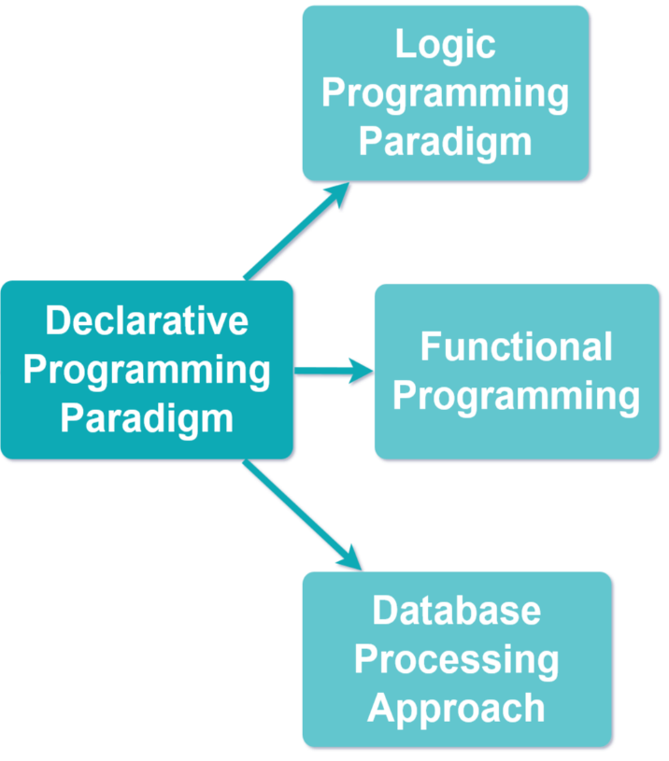
Declarative Programming Paradigm

Slide 17
Logic
This programming is based on formal logic.
Programs are written as a series of facts and rules that follow a logical structure (e.g. ‘X is true if Y and Z are true’).
Logic programming is primarily declarative as machines can use reason to solve a problem, though in some cases imperative commands can also be included in the code.
Logic programming is closely connected to development of machine learning and artificial intelligence.
Examples: Prolog, Datalog, Mercury.

Slide 18
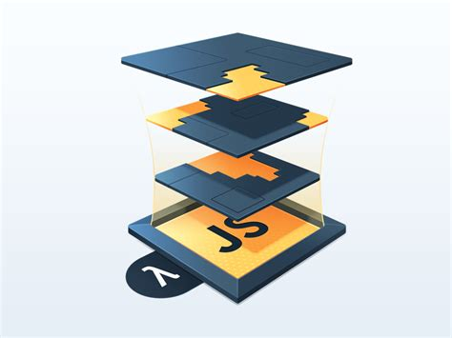
Functional
This type of programming paradigm is based on the execution of a series of mathematical functions, which form the building blocks of the program and perform all manner of tasks.
It avoid flow controls like loops and instead favour recursive functions.
It reduces code complexity and can be used to solve complex problems.
They are difficult to learn and tricky to scale for larger projects.
Examples: JavaScript, Haskell, Scala

Slide 19
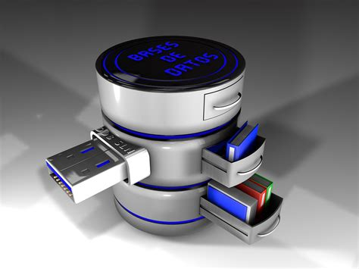
Database Processing Approach
This programming methodology is based on data and its movement.
Program statements are defined by data rather than coding a series of steps
A database program provides file creation, data entry, update, query and reporting functions.
There are several programming languages that are developed mostly for database application.
For example, SQL.

Slide 20
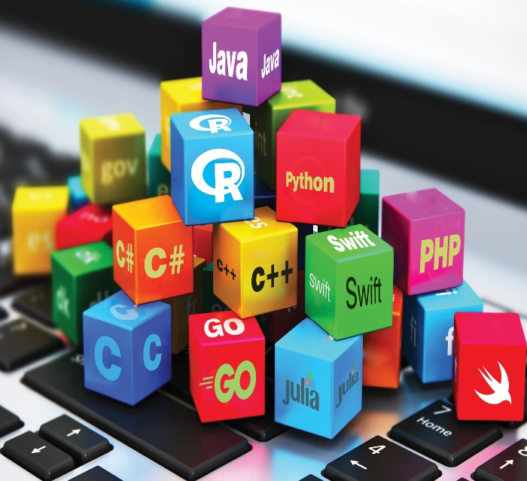
Imperative
Examples
Declarative
Fortran
Java
Pascal
ALGOL
C
C#
C++
Assembler
BASIC
COBOL
Python
Ruby
HTML
XML
XAML
Prolog
SQL

Slide 21
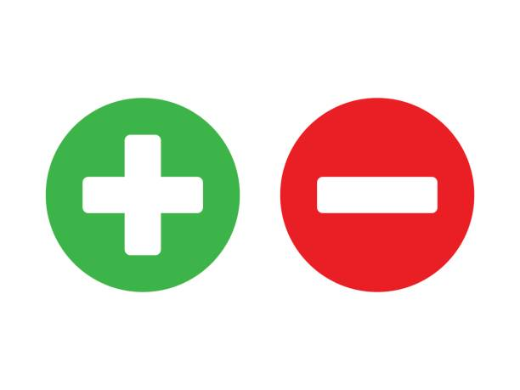
Declarative
Short, efficient code Smaller Program
Can be implemented using methods not yet known at the time of programming
Reuse: it is easier to create code that can be used for different purposes
Maintenance possible independent of application development
More readable and also easier to learn by non-programmers because its closer to human language.
Error recovery: it is easy to specify a construct that will stop at the first error instead of having to add error listeners for every possible error.
Sometimes hard to understand for external people
Based on an unfamiliar conceptual model for people (solution state)
Hard to take characteristics of individual applications into account during programming

Slide 22
Imperative
Quicker and easier to write and maintain
Hardware independent- it is written and can be used many times
Time saving. Its programmer friendly
Good level of control without having to know the precise target CPU details
Portable source code
Slower code. Lacks low level processors functionality
Many languages so programmer may only learn and know only one
Knowledge about programming instruction is required
Doesn’t deal with ideas and concepts

Slide 23
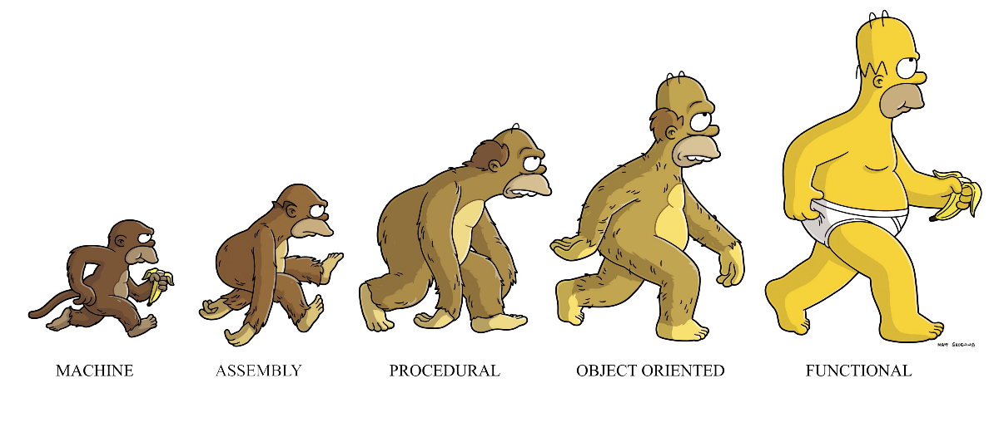
EVOLUTION OF PROGRAMMING LANGUAGES

